Slide 1
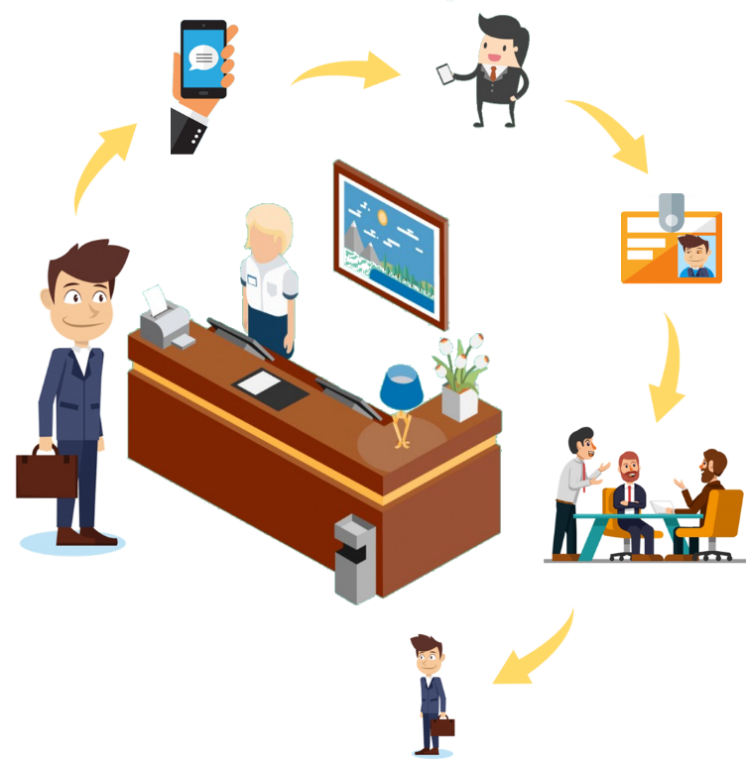
Visitor App!
Has go-live date been shifted?
Go-live has been moved to the 11 October 2021 due to system unavailability during the Transnet-wide network challenges.
Is it possible to SMS the check-in code to the visitor
We will be engaging the network provider to explore the option of check-in codes to be sent to mobile devices in the next phase of the project, for not, it is only through web-based devises. Nothing potential costs.
Which company was responsible to deliver the solution
The solution is proudly local and was delivered by our internal resources. This is truly a TE innovation, by TE and for TE.

Slide 2
Visitor App!
MADE IN TE!
When a visitor has to do multiple deliveries to TE sites, will they utilise the same code?
A visitor check-in code is only valid for one visit and thus a visitor will require different check-in codes.
This also means that if a visitor vacates the premises for lunch or any other reason, they are required to regenerate a new check-in code.
Our sites have multiple entrance/exit points, will all of them be covered?
In the meantime, only the main entry points will be implementing the solution until the solution is rolled out nationally.
What is the next steps after go-live
After go-live, we will conduct a lessons learnt to ensure that the next phase incorporates any additional features requested by the site users. A post go-live support structure has been set-up and is ready to handle any technical challenges that might arise.

